Slide 1
Live tiles
Developer's guide to Windows 10 Insider Preview
Andy & Jerry

Slide 2
Tile basics
Tile templates
Adaptive templates
Adaptive samples
Toast
Interactive toast

Slide 3
Tile basics

Slide 4
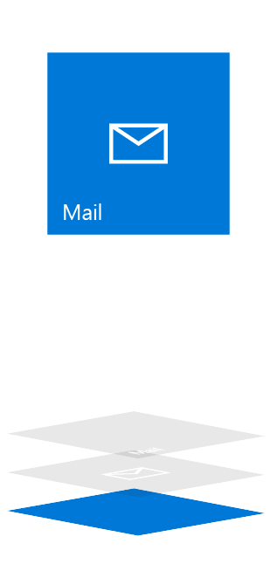
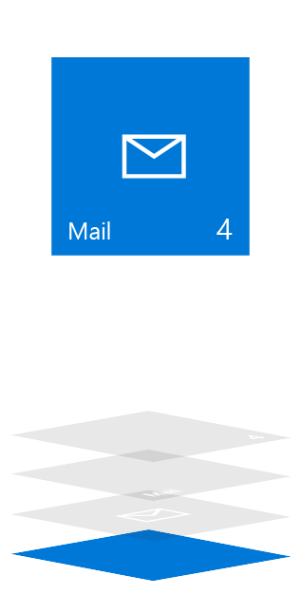
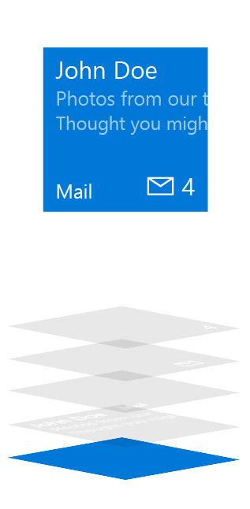
Tile anatomy
Basic State
Semi-Live State
Live State
Plate
Plate
Plate
Content
App Logo
App Logo
App Icon
Badge
Badge
Short Name
Short Name
Short Name
Badge
Badge
App Icon
Short Name
Short Name
Short Name
App Logo
App Logo
Content
Plate
Plate
Plate

Slide 5
Updating tiles
Scheduled
Set template and time with “ScheduledTileNotification”
Periodic
Pull from URL 30m / 60m / 6h / 12h / 24h
Local
Update from (foreground/background) app
Push
Use push services
Update badge

Slide 6
Update tile badge
// build badge
var type = BadgeTemplateType.BadgeNumber;
var xml = BadgeUpdateManager.GetTemplateContent(type);
// updte element
var elements = xml.GetElementsByTagName("badge");
var element = elements[0] as Windows.Data.Xml.Dom.XmlElement;
element.SetAttribute("value", "47");
// send to lock screen
var updator = BadgeUpdateManager.CreateBadgeUpdaterForApplication();
var notification = new BadgeNotification(xml);
updator.Update(notification);

Slide 7
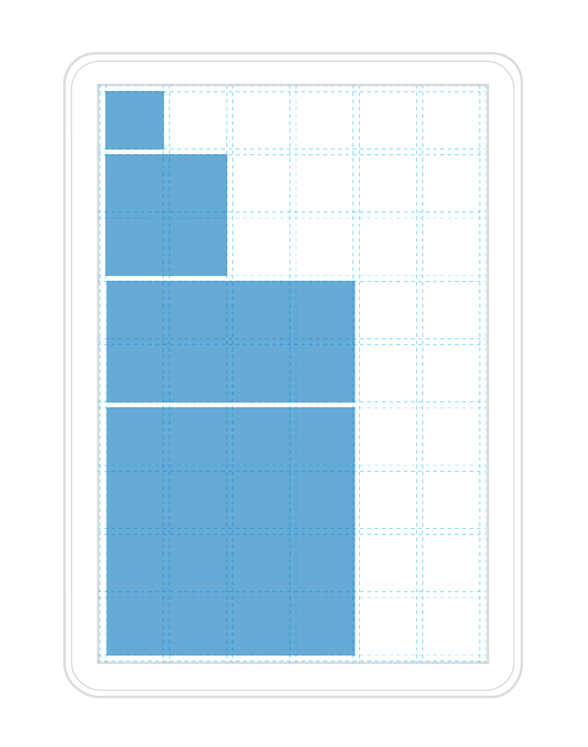
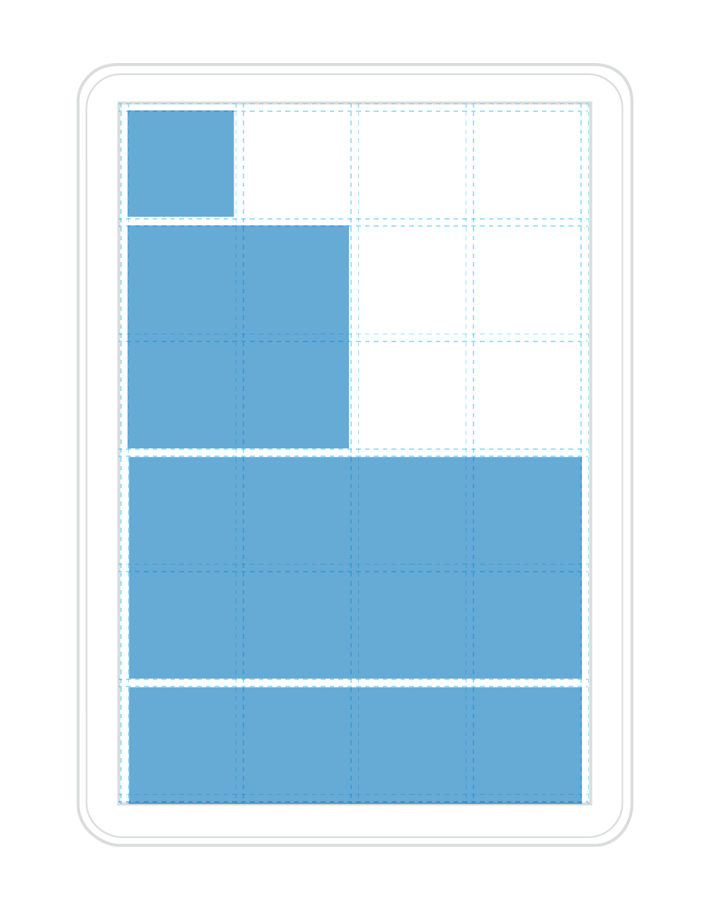
Responsive tiles
Low density example
High density example
Tiles are not always the same size
Tiles adapt to the screen they are on
Since the Start grid has different densities
and adapts to the screen size of your device,
so do our tiles and the content within them.

Slide 8
Tile templates

Slide 9
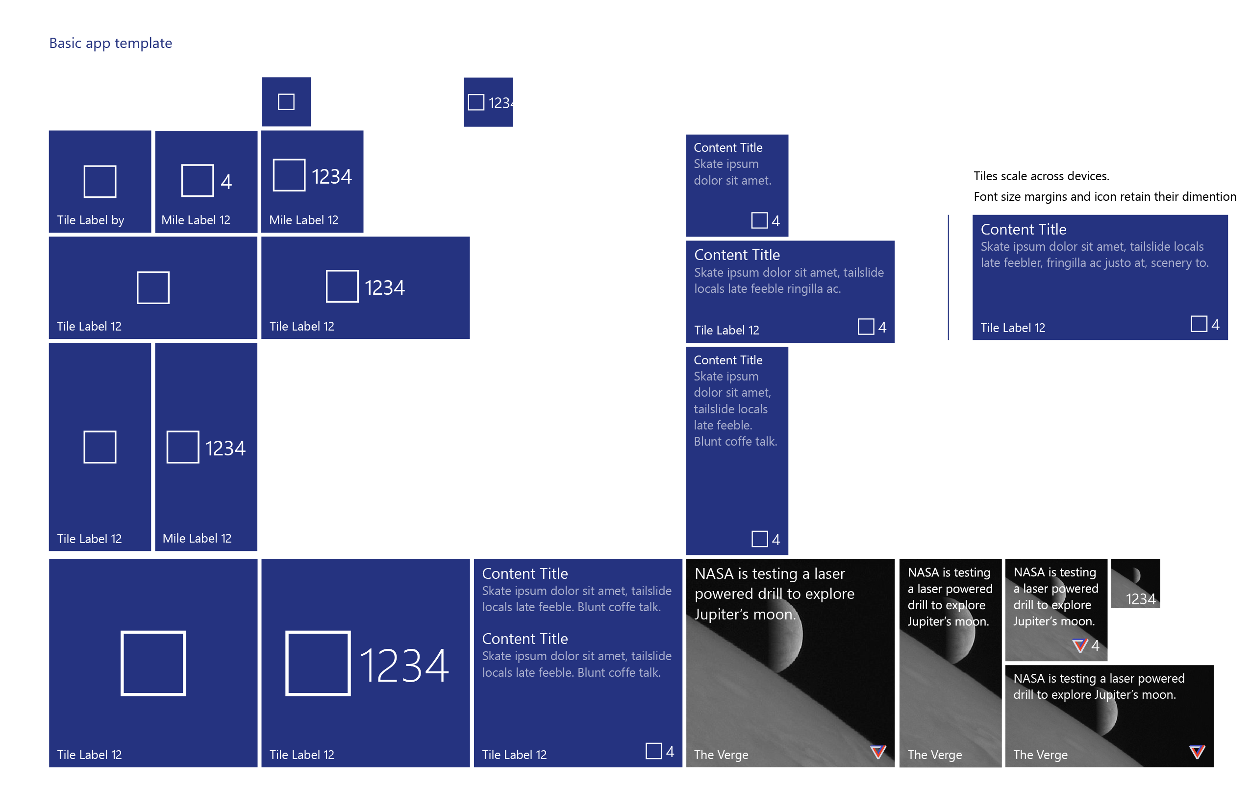

Slide 10
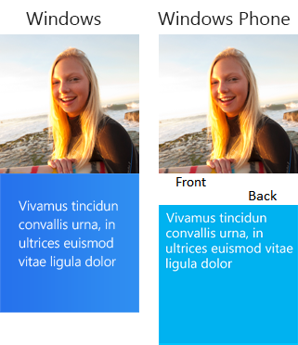
Legacy templates
If a template meets your needs, go ahead and use it.
Previous templates remain
Phone and Windows templates have been merged
There are over 80 templates available

Slide 11
Create a secondary tile
var tileId = "DetailsTile";
var pinned = SecondaryTile.Exists(tileId);
if (!pinned)
{
var tile = new SecondaryTile(tileId)
{
DisplayName = "Record details",
Arguments = "123"
};
// extra details
var success = await tile.RequestCreateAsync();
}

Slide 12
Use secondary tiles to deep-link into your app

Slide 13
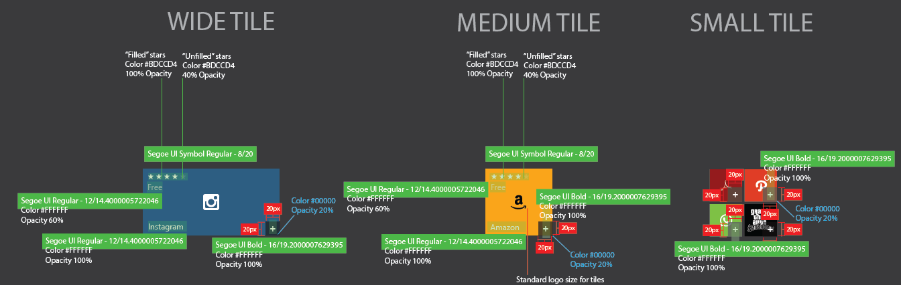

Slide 14
Please don’t say more templates.

Slide 15
Adaptive templates

Slide 16
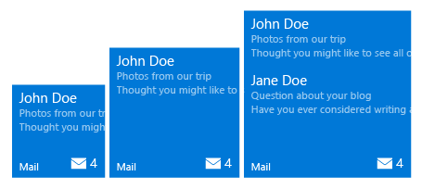
Adaptive tiles
<tile>
<visual>
<binding template="TileMedium">
<group> <subgroup>
<text hint-style="subtitle">John Doe</text>
<text hint-style="subtle">Photos from our trip</text>
<text hint-style="subtle">Thought you might…</text>
</subgroup>
</group>
<group> <subgroup>
…
</subgroup>
</group>
</binding>
</visual>
</tile>
Min. Med Size
Max Med. Size

Slide 17
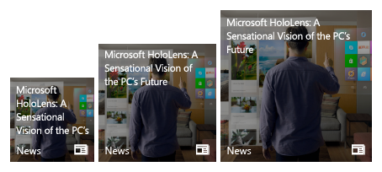
Adaptive tiles
<tile>
<visual>
<binding template="TileMedium">
<image source="Assets\image.png" placement="background" />
<text hint-wrap="true">
Microsoft HoloLens: A
Sensational Vision of the PC’s Future
</text>
</binding>
</visual>
</tile>
Min. Med Size
Max Med. Size

Slide 18
Adaptive samples

Slide 19
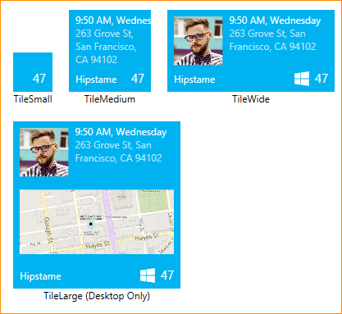
Sample: Small Tile
<binding template="TileSmall"
branding="none" hint-textStacking="center">
</binding>

Slide 20
Sample 1: Medium Tile
<binding template="TileMedium"
branding="Name" displayName="Hipstame">
<text hint-style="caption">
9:50 AM, Wednesday</text>
<text hint-style="captionsubtle" hint-wrap="true">
263 Grove St, San Francisco, CA 94102</text>
</binding>

Slide 21
Sample: Wide Tile
<binding template="TileWide" displayName="Hipstame">
<group>
<subgroup hint-weight="33">
<image placement="inline" src="http://image.jpg" />
</subgroup>
<subgroup>
<text hint-style="caption">
9:50 AM, Wednesday</text>
<text hint-style="captionsubtle"
hint-wrap="true" hint-maxLines="3">
263 Grove St, San Francisco, CA 94102</text>
</subgroup>
</group>
</binding>

Slide 22
Sample: Large Tile
<binding template="TileLarge" displayName="Hipstame">
<group>
<subgroup hint-weight="33">
<image placement="inline" src="http://image.jpg" />
</subgroup>
<subgroup>
<text hint-style="caption">
9:50 AM, Wednesday</text>
<text hint-style="captionsubtle"
hint-wrap="true" hint-maxLines="3">
263 Grove St, San Francisco, CA 94102</text>
</subgroup>
</group>
<image placement="inline" src="http://map.jpg"/>
</binding>

Slide 23
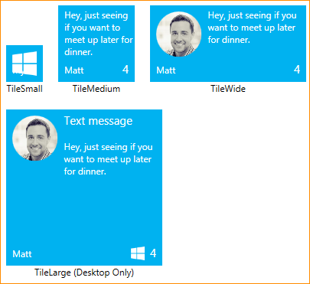
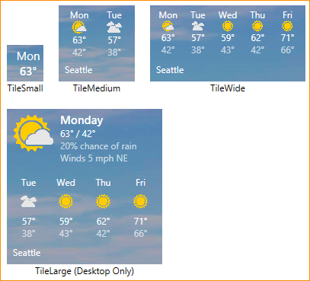
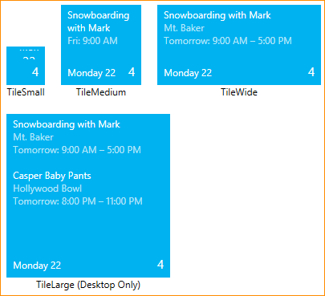
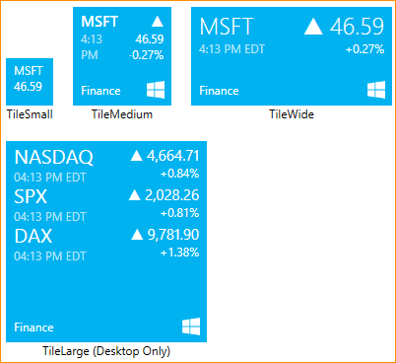
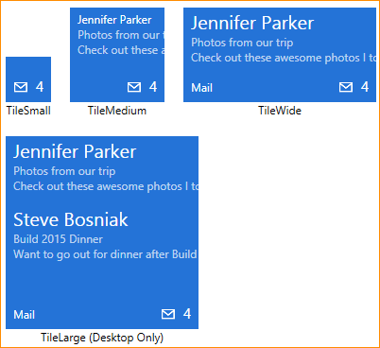
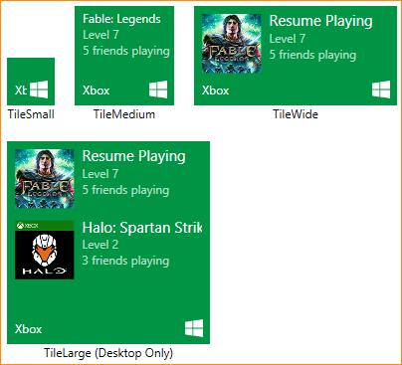
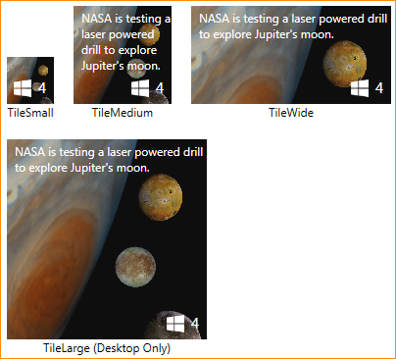
Adaptive
Templates

Slide 24
Toast

Slide 25
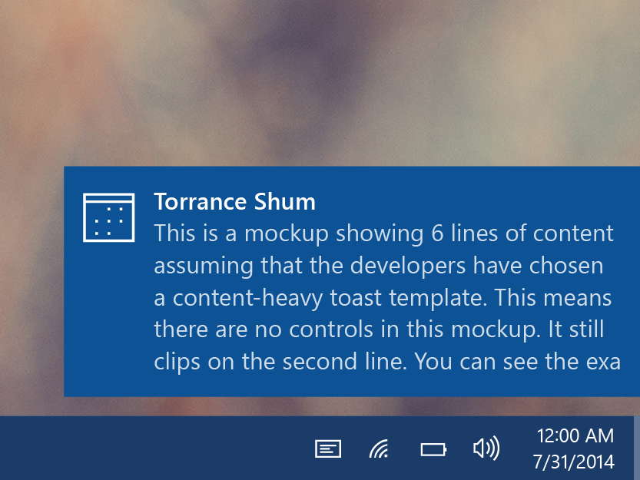
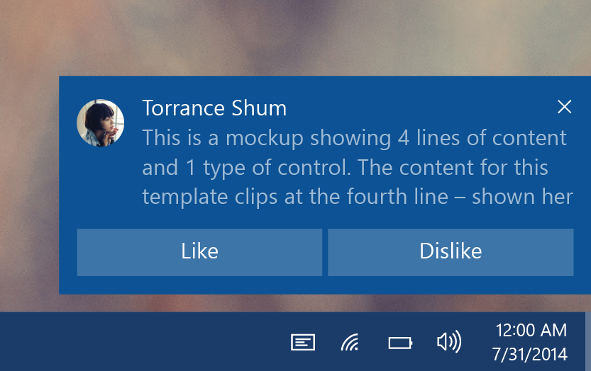
Toasts
Glance (consume)
See new information from your apps.
Act (chase, or take actions)
Toasts invite you to begin or complete a task.
The toast is the app’s door by chasing (clicking) it.
Additional actions enable users to perform simple tasks without context switching.

Slide 26
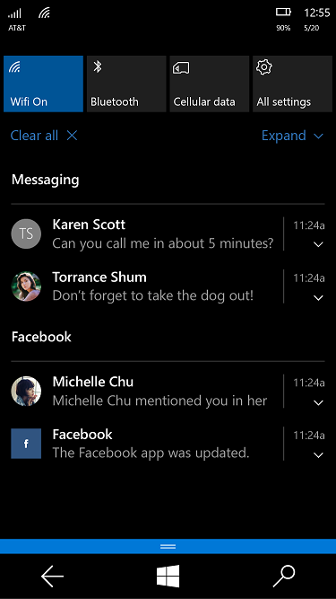
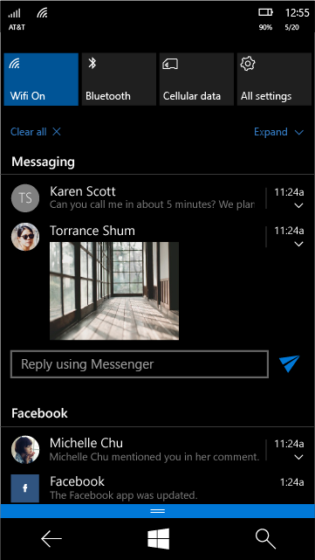
Toast states
Collapsed state
Action center chevron
Mobile default
Expanded state
Action center chevron
Desktop default

Slide 27


Toast templates
If a template meets your needs, go ahead and use it.
Previous templates remain
Phone and Windows templates have been merged
Adaptive template
Same XML syntax as tiles

Slide 28
Sending toast
Scheduled
Set template and time with “ScheduledToastNotification”
Toast can also be set to be recurring.
Local
Send from (foreground/background) app
This includes desktop apps with “AppUserModelID”
Push
Use push services

Slide 29
Sending toast
// build toast
var template = ToastTemplateType.ToastText01;
var xml = ToastNotificationManager.GetTemplateContent(template);
xml.DocumentElement.SetAttribute("launch", "Args");
// set value
var text = xml.CreateTextNode(content);
var elements = xml.GetElementsByTagName("text");
elements[0].AppendChild(text);
// show toast
var toast = new ToastNotification(xml);
var notifier = ToastNotificationManager.CreateToastNotifier();
notifier.Show(toast);

Slide 30
Sending toast
// build toast
toast = new ToastNotification(toastXml);
toast.Tag = tag;
toast.Group = group;
// show toast
var notifier = ToastNotificationManager.CreateToastNotifier();
notifier.Show(toast);

Slide 31
Handling activation
void OnActivated(IActivatedEventArgs args)
void OnLaunched(LaunchActivatedEventArgs args)
if (args.Kind == ActivationKind.Launch
&& args.Arguments != null && args.TileId != "App") { /* handle toast */ }
if (args.Kind == ActivationKind.Launch
&& args.Arguments == null && args.TileId != "App") { /* handle primary tile (or toast) */ }

Slide 32
Interactive toast

Slide 33
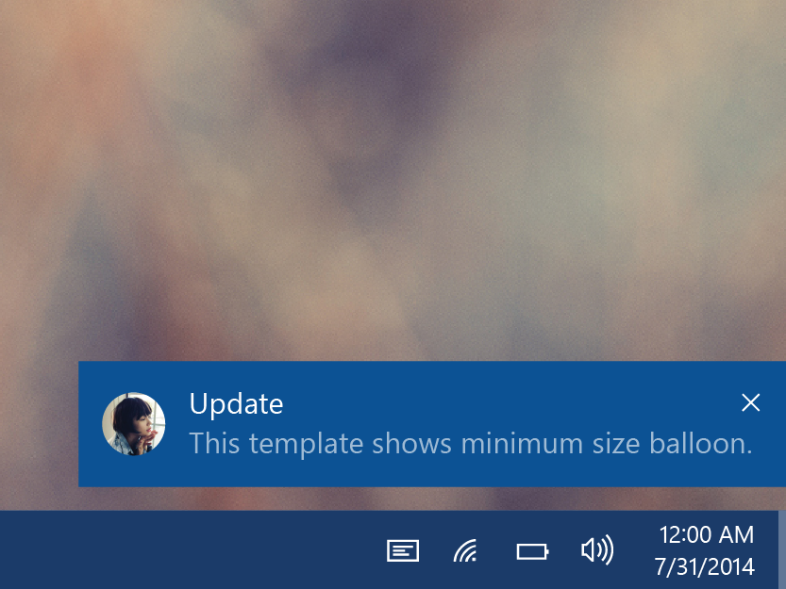
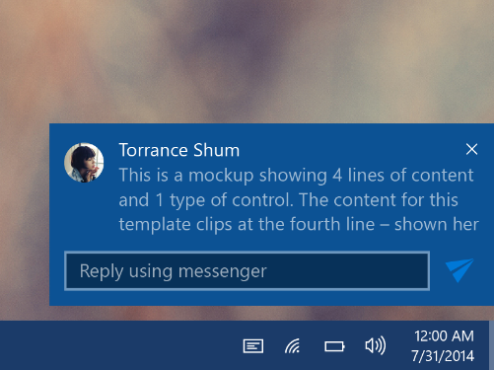
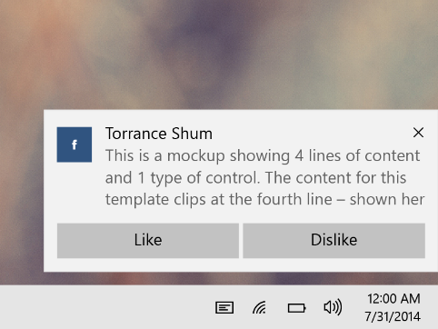
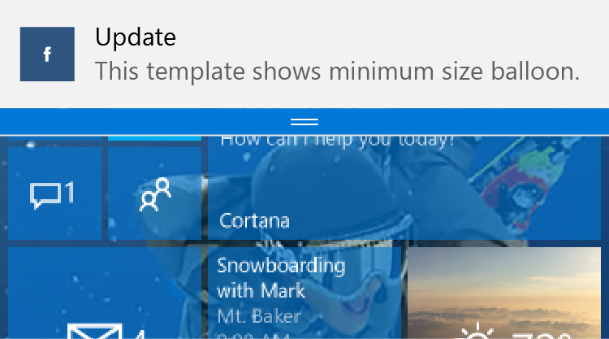
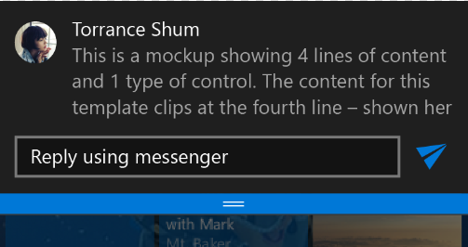
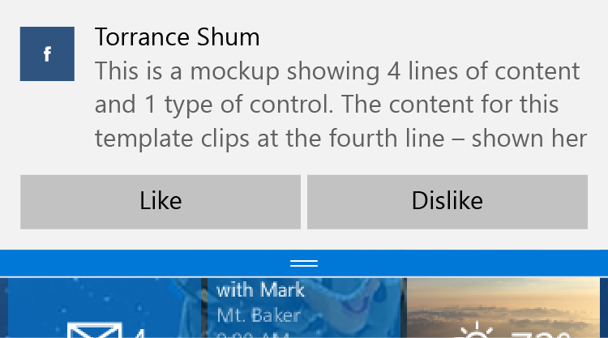
Interactive toast
Desktop
Mobile

Slide 34
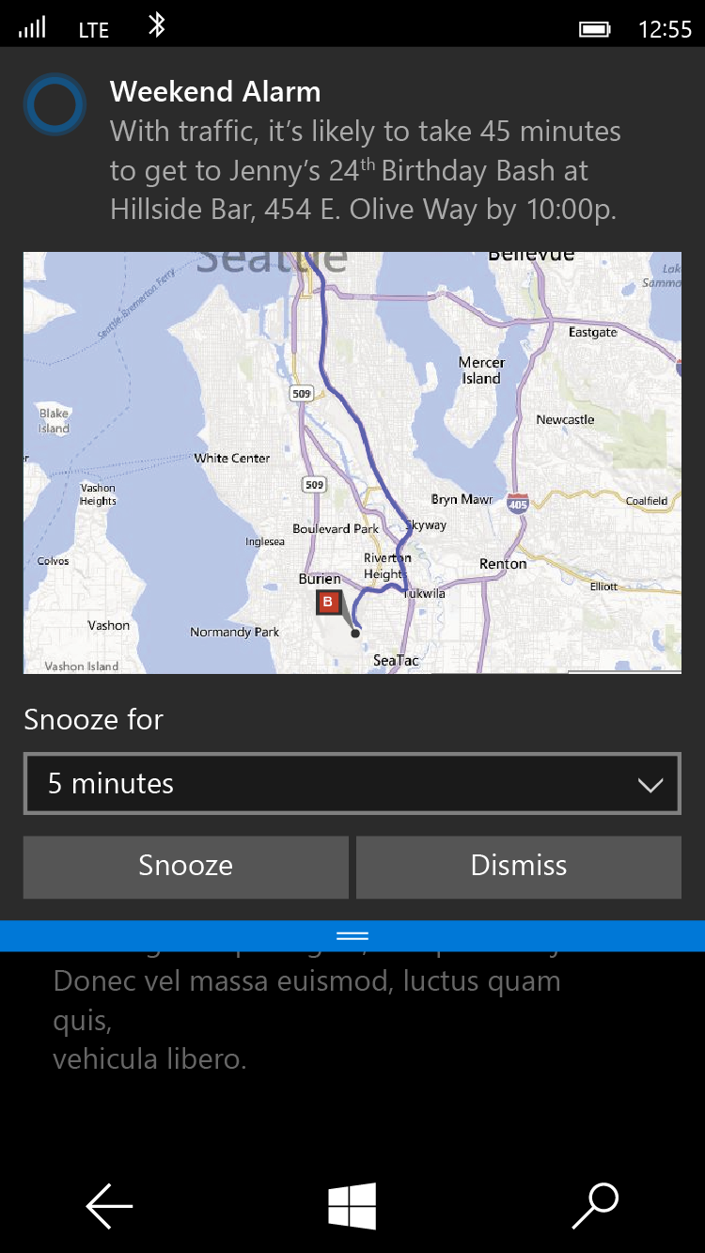
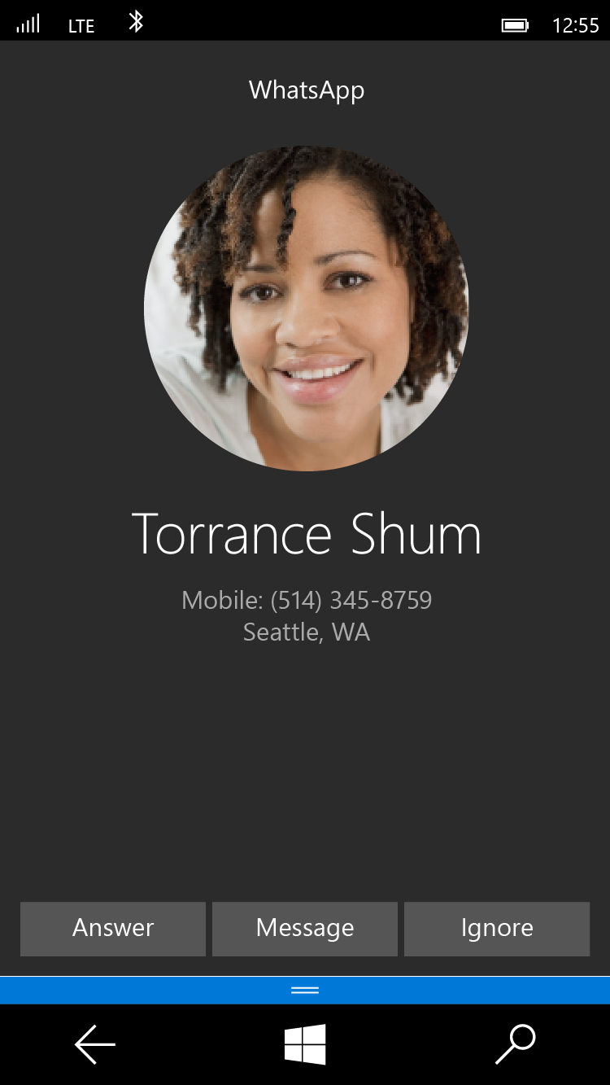
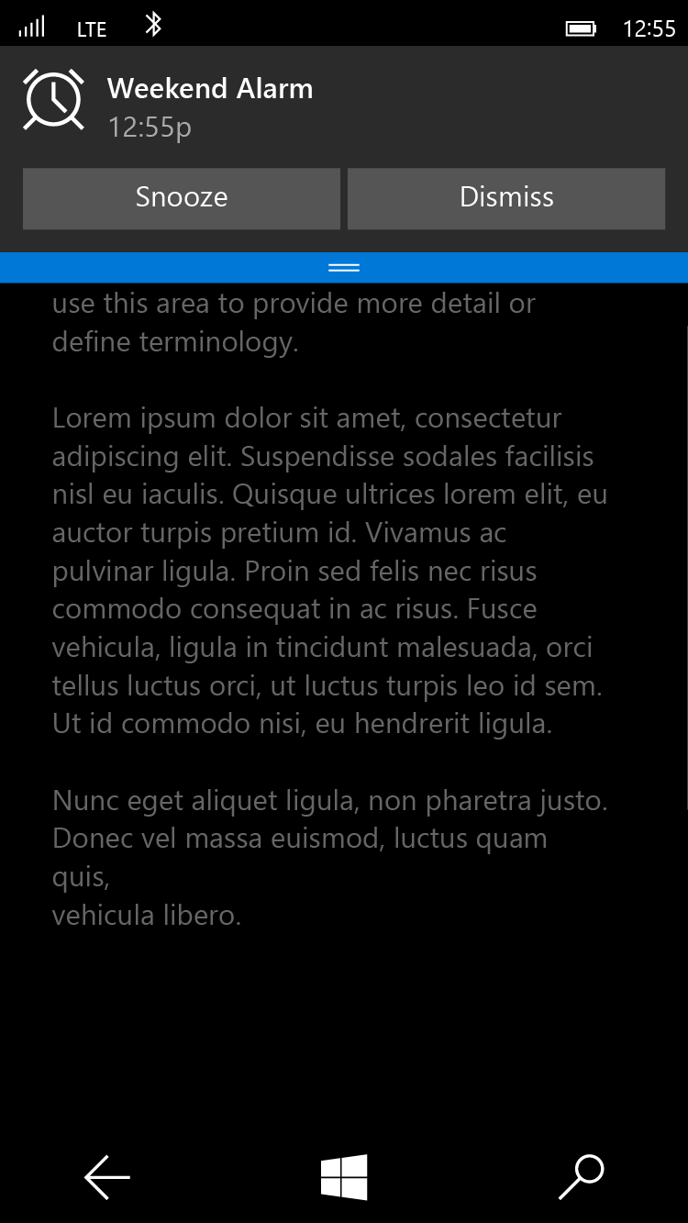
Special Toast Scenarios
Alarm
<toast scenario=“alarm”...>
Reminder
<toast scenario=“reminder”...>
Incoming Call
<toast scenario=“incomingCall”...>

Slide 35
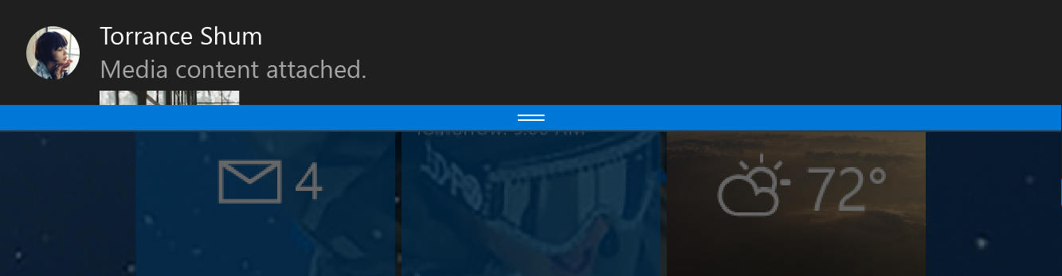
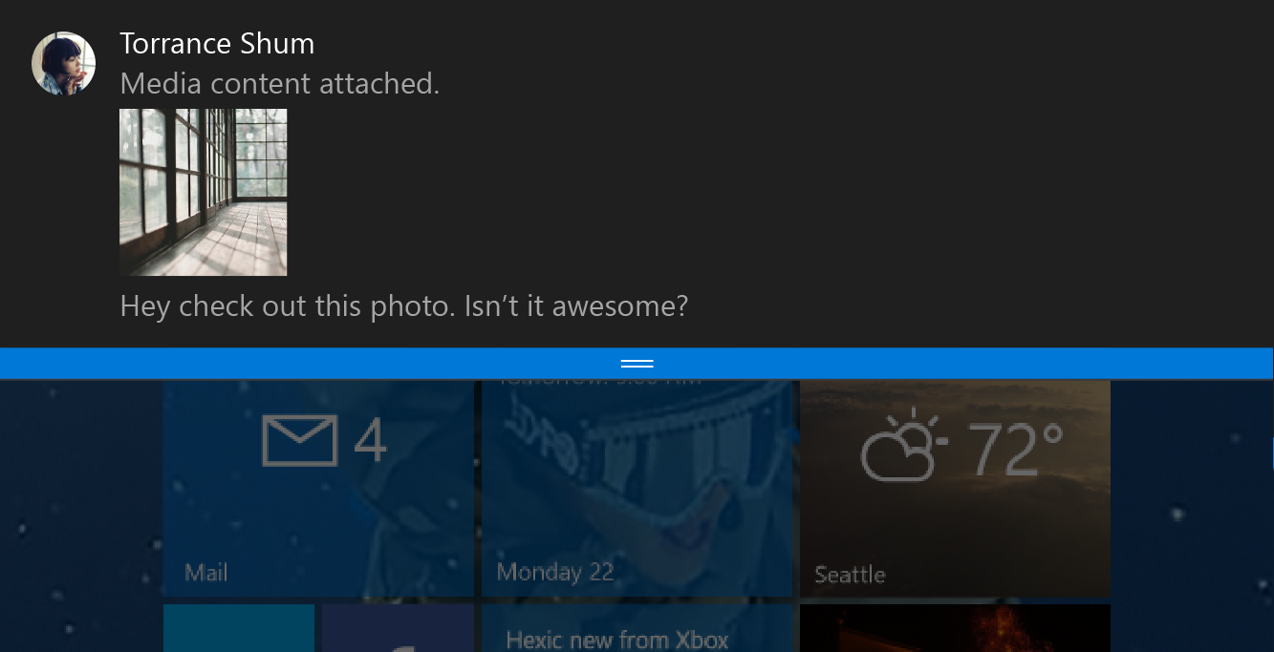
Toast notifications
<toast>
<visual>
<binding template="ToastGeneric">
<image placement="appLogoOverride"
src="Torrance Shum.png" />
<text>Torrance Shum</text>
<text>Media content attached.</text>
<image placement="inline"
src="attachment.png" />
<text>Hey check out this photo.
Isn’t it awesome?</text>
</binding>
</visual>
</toast>

Slide 36
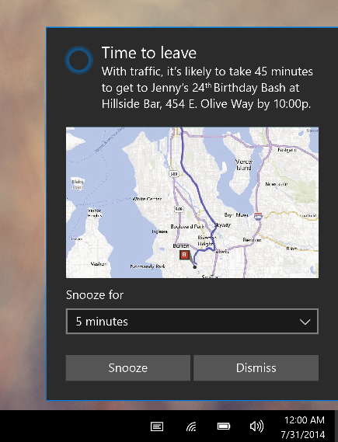
Toast input
<toast>
...
<actions>
<input title=“Snooze for” id="snoozeTime"
type="selections" defaultSelection=“5">
<selection id="5" content="5 minutes" />
<selection id="10" content="10 minutes" />
<selection id="20" content="20 minutes" />
</input>
...
</actions>
</toast>

Slide 37
Toast action
<toast>
...
<actions>
...
<action activationType="system" arguments="snooze" hint-inputId="snoozeTime" content=""/>
<action activationType="system" arguments="dismiss" content=""/>
</actions> </actions>
</toast>

Slide 38
Alarms are Toasts
<toast scenario=“alarm”...>
<visual>
...
</visual>
<actions>
<action activationType='system' arguments='snooze' content='' />
<action activationType='system' arguments='dismiss' content=''/>
</actions>
</toast>

Slide 39
Toast customization
<toast>
...
<image placement="appLogoOverride" src="Logo.png" />
...
<actions>
...
<action activationType="background"
arguments="dismiss"
imageUri="send.png"
hint-inputId="1" />
</actions>
</toast>

Slide 40
New activation types & activations
<action activationType="foreground" />
<action activationType="background" />
<action activationType="protocol" />
<action activationType="system" />
Tap button
App launches
Retrieve Args
Take actions
Tap button
Task launches
Retrieve Args
Take actions
Tap button
Protocol activates
Web / app
Tap button
System handles
Notes:
Add system here as well.
Add one more action to each foreground / background to take actions based on the retrieved args.

Slide 41
Tile basics
Tile templates
Adaptive templates
Adaptive samples
Toast
Interactive toast

